Slide 1
Harmonizing residential emissions across borders to tackle the air quality problem in the hotspot region of
Southern Poland, the Czech Republic and Slovakia
Nele Veldeman, Inge Uljee, Stijn Vranckx, Lisa Blyth and Stijn Janssen VITO, Mol, Belgium
Jana Krajcovicova and Dusan Stefanik SHMU, Bratislava, Slovak Republic
Ondřej Vlček and Kateřina Honzáková CHMI, Prague, Czech Republic
Piotr Łyczko Marshal Office Małopolska, Kraków, Poland

Slide 2

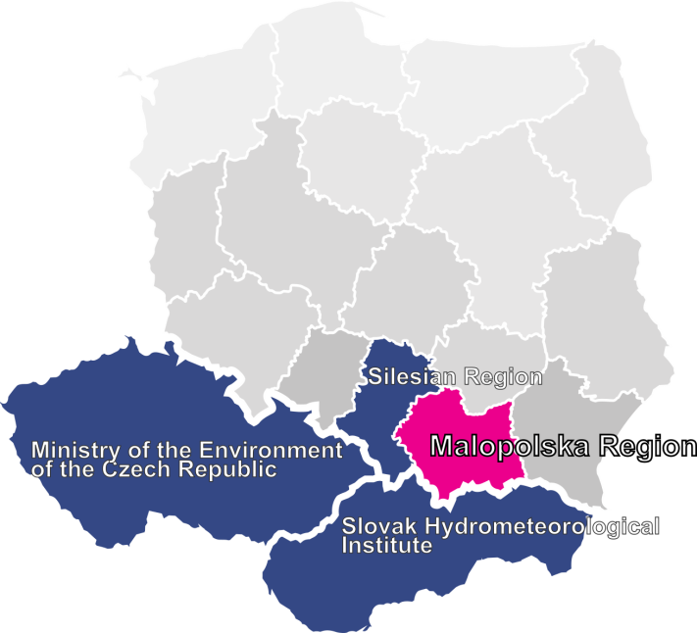

Implementation of Air Quality Plan for Małopolska Region
Context
Implementation of Air Quality Plan for Małopolska Region – Małopolska in a healthy atmosphere
(LIFE IPE PL 021)
Key objective is to accelerate the implementation of the “Air Quality Plan for the Małopolska Region” & improve air quality in the region
Planned actions: from grassroots to regional level
Budget: €16.8M ; Additional actions: €800M
Duration: Oct 2015 – Dec 2023
Notes:
LOCAL: 60 Eco-managers across 55 municipalities
LOCAL actions - sustainable urban transport PLANS
REGIONAL POLICY - Anti-smog regulations, solid fuel ban in Krakow, implementation of eco-design standards Malopolska,

Slide 3
Air Quality Modelling Platform for the whole Hotspot
Modelling Action
Goal: Development of an inter-regional framework for both emissions and air quality, to ascertain the ‘current’ AQ situation & use it as a reference to assess large-scale emission scenarios based on planned/proposed (residential) emission reduction actions in the regions (by 2023)
How:
Harmonised Low Stack Emission Inventories
  Per region
  SK, CZ, Malopolska, Silesia
  EISSA (VITO tool)
Trans-boundary Emission Data Base
  Bottom-up & Top-down (CHMI)
  BaP emission data base (SK)
Inter-regional Air Quality Modelling
  CMQ (BaP) (SK)
  CAMx model (CHMI)
  RIO model (VITO)
  Inter-comparison (all)
  Air Quality Plan Scenarios
Capacity building Outreach
  Bulgaria
  Romania
  Other Polish regions…

Slide 4
On a shoe string
Harmonised Low Stack Emission Inventories
Comprehensive high resolution transboundary emission inventory for residential emissions
Per sub-region
Based on a harmonized methodology
Implemented in the EISSA software
→ consistent inventory covering whole hotspot region

Slide 5
WORKFLOW of harmonization procedure
Harmonised Low Stack Emission Inventories
Inventory of methodologies
  Identification of similarities and differences
    Similarities → common approach agreed upon
    Differences → harmonization required/desired/not necessary?
Differences due to ‘real’ differences,
  reflect the reality for specific area in the best possible way
  → stick to different methods (or at least aspects thereof) in different regions
Differences linked to availability of basis input data
  methodologies are strongly related to data availability
        → agree upon a methodology which easily allows updates in the future

Slide 6
WORKFLOW of harmonization procedure
Harmonised Low Stack Emission Inventories
Differences related to different opinions, the lack of harmonization over regional borders in the past, ...
  not necessarily reflecting ‘reality
  harmonization of approaches over all sub-regions, would (in this case) lead to more consistent emissions, without causing a loss of accuracy
        → Harmonize to the fullest
        → Challenge: find the best overall approach

Slide 7
FINDINGS related to harmonization procedure
Harmonised Low Stack Emission Inventories
Lot of similarities, yet crucial differences exist
  activity data
    based on fuel consumption vs. heat consumption
    based on statistical data vs. based on surveys
  varying emission factors (EFs)
  different
    level of detail
    approaches wrt the methodology
Harmonization of methodologies over all sub-regions not straightforward,
and in the end appeared to be too challenging
→ pairwise harmonization
    Małopolska and Silesia Region
    Slovakia and the Czech Republic

Slide 8
harmonization of Slovakia & Czech Republic
Harmonised Low Stack Emission Inventories
Harmonization of general parameters
  Substances
  Sectors and subsectors
  Fuel types
Harmonization of emission estimation methodology
Fuel parameters
Shares of different fuel types
Census data information
Emission factors
Annual heat demand
Annual fuel consumption
Emissions
Notes:
In the regional inventories, ‘Residential Emissions’ is understood as ‘Heating by Households’, or NFR sector 1A4bi.
In national inventories (e.g. EMEP, TNO-MACC, …) ‘Residential Emissions’ also contain emissions reported under the NFR sectors 1A4ai, 1A4ci,and 1A5a.
Computation of annual heat demand per dwelling unit, requiring census data information
Computation of annual fuel consumption per basic unit, requiring fuel parameters, statistical distribution of different fuel types per basic unit & output of step 1
Computation of emissions, requiring, emission factors and output of step 2

Slide 9
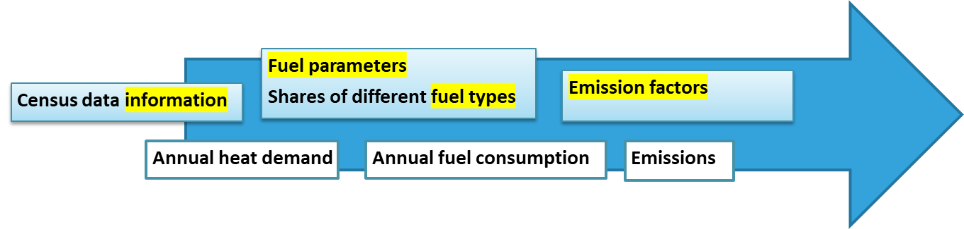
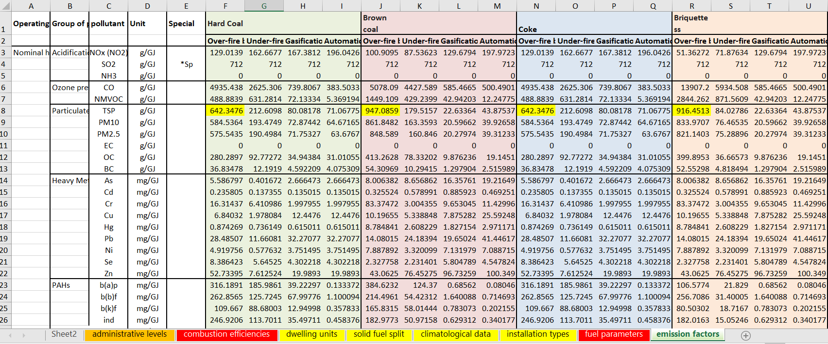
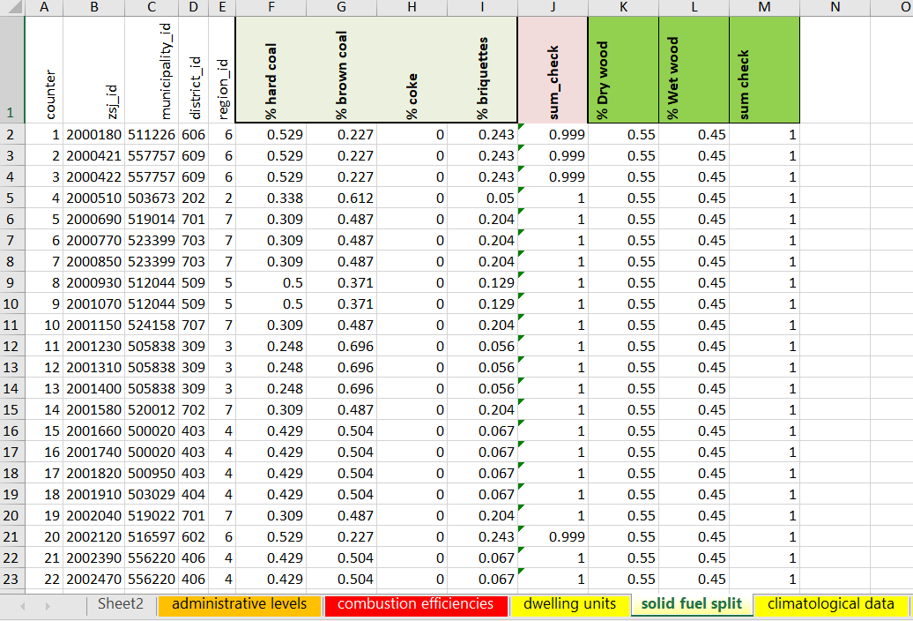
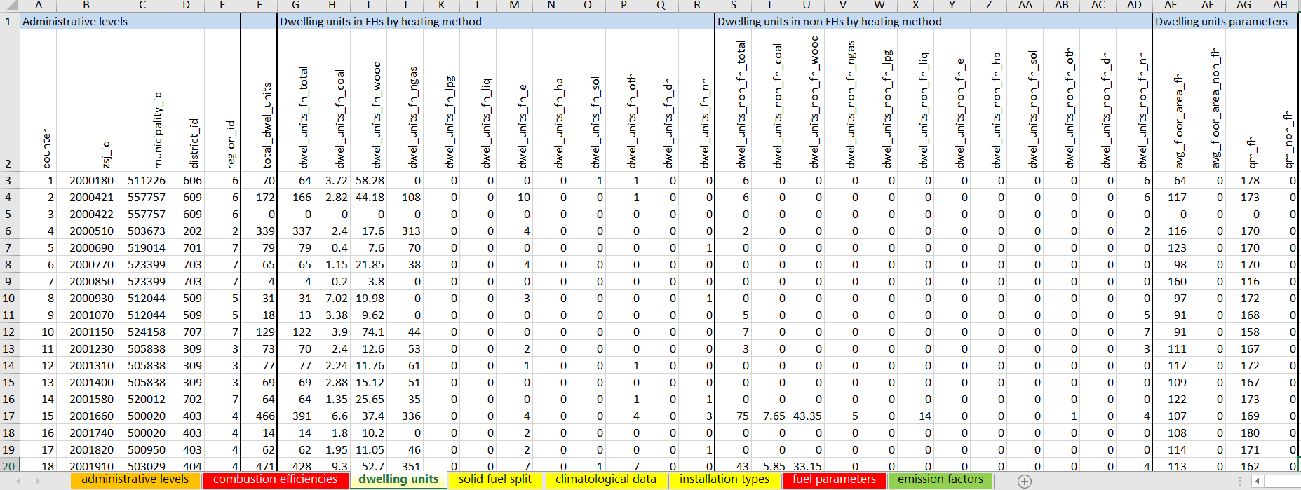
harmonization of Slovakia & Czech Republic
Harmonised Low Stack Emission Inventories
Notes:
In the regional inventories, ‘Residential Emissions’ is understood as ‘Heating by Households’, or NFR sector 1A4bi.
In national inventories (e.g. EMEP, TNO-MACC, …) ‘Residential Emissions’ also contain emissions reported under the NFR sectors 1A4ai, 1A4ci,and 1A5a.
Computation of annual heat demand per dwelling unit, requiring census data information
Computation of annual fuel consumption per basic unit, requiring fuel parameters, statistical distribution of different fuel types per basic unit & output of step 1
Computation of emissions, requiring, emission factors and output of step 2

Slide 10
harmonization of Slovakia & Czech Republic
Harmonised Low Stack Emission Inventories
Methodology to compute of annual heat demand for different fuel types
The specific heat consumption
  a certain (literature or census based) value (CZ)
  the result from a specific calculation in preprocessing (SK)
There has been quite some discussion on the conversion coefficient between normalized and actual climatic conditions.
The average floor area, P, is not always known
  missing values being gapfilled in preprocessing (CZ)
  missing values being replaced on the fly with the national average (SK)

Slide 11
EISSA – Emission Inventory Support System Air
EISSA Platform
EISSA: Emission Inventory Support System – Air
One of the products based on the EISS framework
  EISS: framework, empty box
  Functionalities depending on product (WEISS, EISSA, HEISS)
User friendly tool
  Developed by VITO in former LIFE project
  To support emission reporting, analysis of emissions and production of emission maps
LIFE-IP Malopolska:
  Sophisticated bottom-up residential emission model
  For the sake of the EISSA demo: extension with other sectors

Slide 12
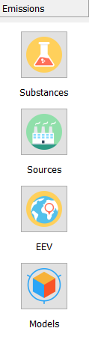
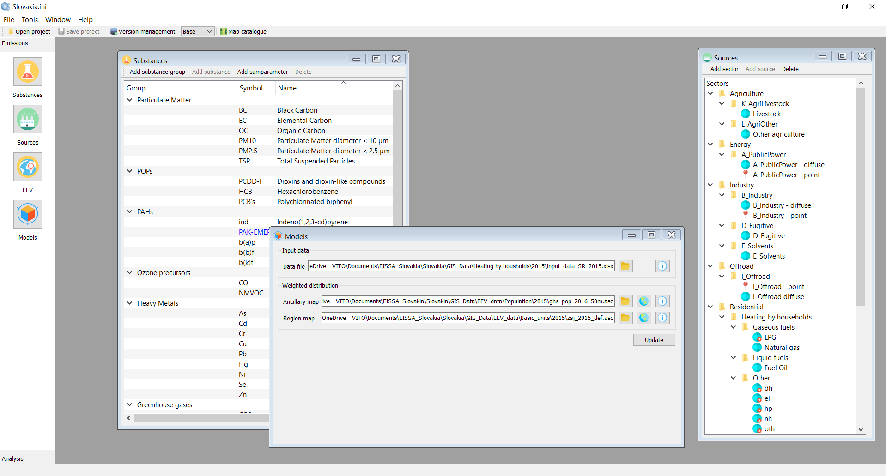
EISSA – application for (residential) emissions in Slovakia
EISSA Platform

Slide 13
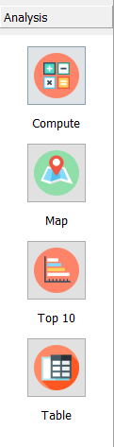
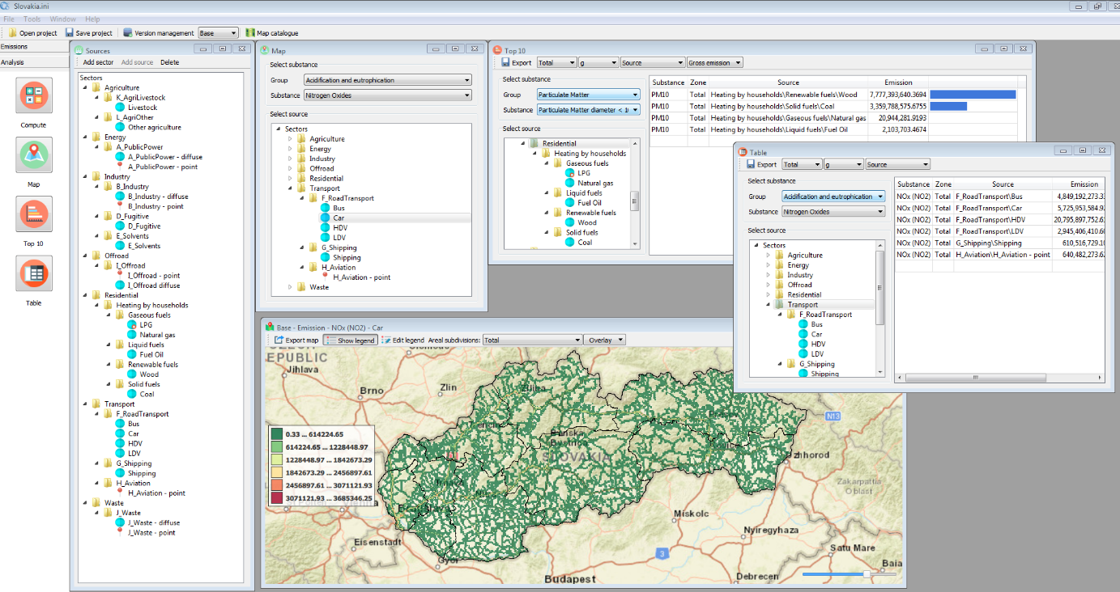
EISSA – application for (residential) emissions in Slovakia
EISSA Platform

Slide 14
Trans-boundary Emission Data Base
Trans-boundary Emission Data Base
Hotspot area:
  Residential emissions
  Emissions transport, industry, agriculture, … from local inventories
Europe outside of hotspot area: TNO MACC-III emissions
Biogenic emissions: MEGAN model
Benzo(a)pyrene emissions: prepared by Johannes Bieser from Hamburg University

Slide 15
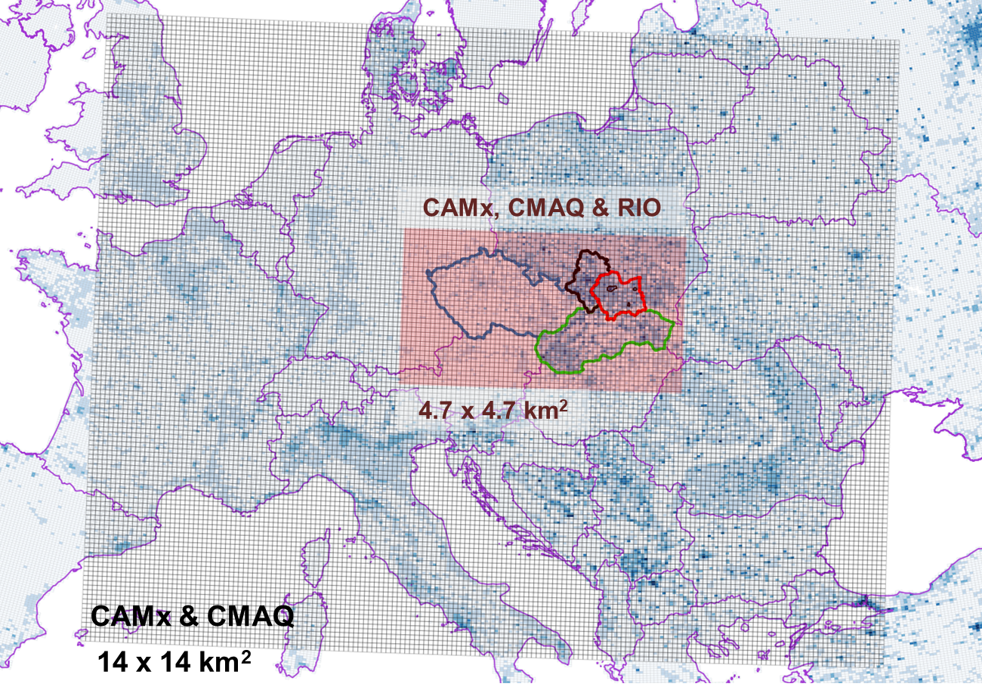
Modelling Approach
Air Quality Modelling
  Set up and ran CAMx & CMAQ (CTM)
  Set up measurement-based land-use regresion model RIO for near real time and historic air quality assessments
  Intercomparison of CTM and RIO model results
  Combination of CTM and RIO tools for the evaluation of the emission reduction scenarios

Slide 16
(Harmonized) emissions modelling framework
COnclusions
Harmonization of methodologies over all sub-regions not straightforward,
and in the end appeared to be too challenging → pairwise harmonization
Emission modelling framework enables the calculation of homogeneous emission fields without boundary effects, thus suitable for integration in regional air quality modelling applications.
Adoption of the framework by each region/country involved guarantees that the development and implementation of regional/national policies aimed at improving the air quality will be done in a homogeneous way, exploiting trans-boundary benefits.

